Slide 1

Prediction of Fraud Transaction on Ethereum
Chaw Hnin Nandar

Slide 2

Agenda
What is Ethereum
Data Explanation & Preparation
Model Recommendation
Important Features
Assumptions and Limitations
Recommendations
Q & A
Objectives
The growth of Ethereum
Key Messages
Ethereum Value changes over years
References
Model Comparison

Slide 3
What is Ethereum
A digital currency platform with a block chain system
The second largest cryptocurrency platform – sending, receiving, trading, mining blocks, writing rules and creating smart contracts, buying Ethereum Tokens, etc.
Ether – the value of Ethereum, “1 Ether” = “1927 USD” by 15th August
Gas – amount of Ether to complete services on Ethereum
Smart contracts – Users’ accounts work on Ethereum Virtual Machine – financial system and decentralized autonomous organization
Ethereum Token - Fungible , non-fungible

Slide 4
Ether Value changes over years
1000 times within 3 years from 2015
It peaked to over $4400 last year and it can be said the highest Ether Value throughout the history
The price of Ether is assumed to grow more than 300% in the year 2022 as it peaked to more than 3 times from its lowest amount in 2021

Slide 5
The growth of Ethereum
Jumped to almost 100 times in 2 years from 2015
Since from 2020, grows yearly without dropping down in average
As the number of transactions per day have been increasing gradually since 2020, it will continue growing in next years.

Slide 6
Key Messages from this project
With the increasing number of transactions per day, it is crucial to improve the security of the system. Predicting fraud transactions on Ethereum will reduce the number of normal users being scammed.
There are always changes in cryptocurrency market such as inflation, recession which can impact the performance of the predicted model of this project.
The model should be modified quarterly to be familiar with updated features of Ethereum and activities of users.

Slide 7
Objectives
To predict an incoming transaction as a fraud or non-fraud to protect the users from losing their property by being scammed
To reduce the scams on Ethereum and improve its performance
To make Ethereum more reliable and secure cryptocurrency platform
To increase the demand of Ethereum which will also increase the price of Ether and make more profit to both the company and the users

Slide 8
Data Explanation
The data set found on Kaggle was used to predict fraud transaction
https://www.kaggle.com/datasets/vagifa/ethereum-frauddetection-dataset
It includes variables related to transaction information on Ethereum which were collected in 2020.
Total 51 variables with 9841 records include
The data is imbalanced - 22% fraud

Slide 9
Data preprocessing
Python will be used in this project to build a predictive model.
Before building a model, the data set was cleaned to avoid complexity and better accuracy
Some variables which are not helpful and highly correlated were dropped.
Some transactions have missing values and they were replaced by median value of that variable.
Duplicated records were also removed
Make the original data to be balanced to avoid overfitting or underfitting the model
Notes:
To reduce complexity

Slide 10
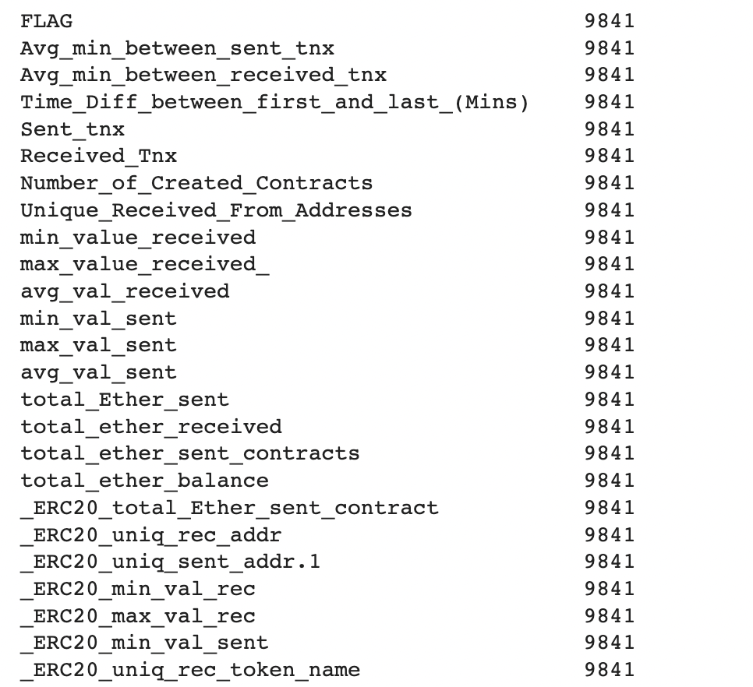
Data training
1 Target Variable
“FLAG” – 0 as non-fraud,1 as fraud
24 Input Variables
27 Independent Variables were dropped

Slide 11
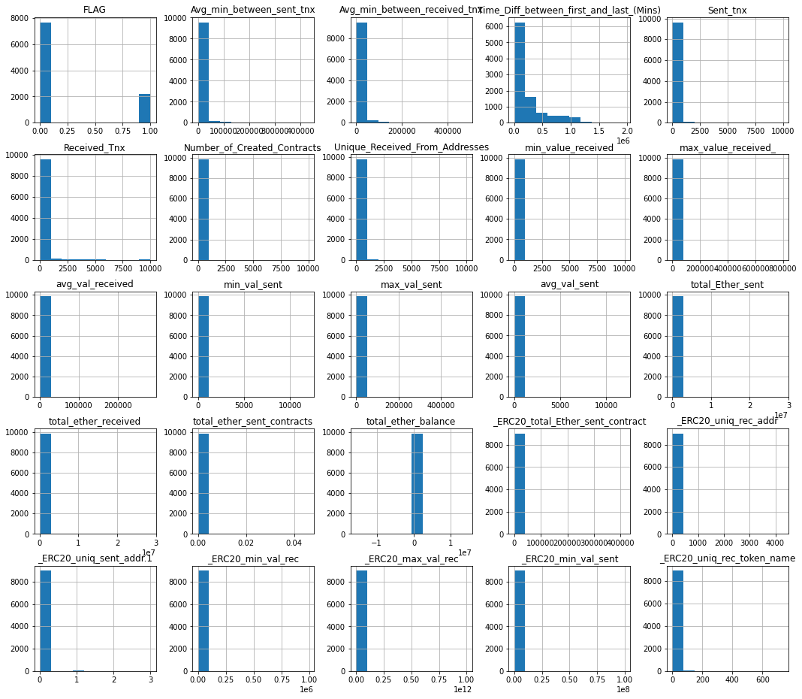
Distribution of each variable

Slide 12
Model Comparison
 | Logistic Regression | Random Forest | XG Boost
Accuracy for Test data | 78.10% | 96.63% | 97.03%
Accuracy for Train data | 83.40% | 98.42% | 98.09%
F1 score | 64.70% | 92.70% | 93.57%
AUC score | 0.93 | 0.9945 | 0.9954
RMSE | 0.4679 | 0.1836 | 0.1722
F1 score – rate of performance of a model
AUC score – how accurately the model can classify between fraud and non-fraud transactions
RMSE – Root mean square error of a model
Notes:
F1 score is the average performance of a model depending on precision and recall. The higher the score, the better the model is.

Slide 13
Model Recommendation
XG Boost ( Extreme Gradient Boosting) will be used to predict fraud transaction
Flexible, efficient and time saving predictive model
Accuracy for real data is 97.03%
2.57% False Negative, 3.08% False Positive
 | Non-fraud | Fraud
Non-fraud | 531 | 59
Fraud | 14 | 1857
Notes:
The model will incorrectly predict 2 fraud as non fraud out of 100 transactions
The model will incorrectly predict 3 non fraud as fraud out of 100 transacions

Slide 14
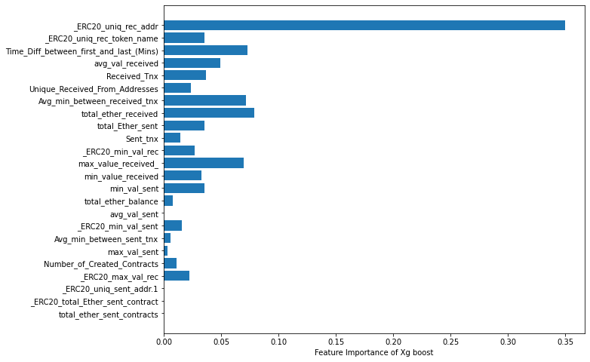
Variable distributions in Xg boost model

Slide 15
Important features
Five Most Important Features
number of ERC20 token transactions received from unique addresses,
Four Least Important Features
Average value of Ether ever sent
total ether received for account address,
time difference between the first and last transaction,
average time between received transactions for account in minutes
Number of ERC20 token transactions sent to Unique account addresses
Total ERC20 token transfer to other contracts in Ether
Total Ether sent to Contract addresses
Maximum Value in Ether ever received

Slide 16
Assumptions and limitations
The input data is two years behind, some limitations to new features added by Ethereum
Although there were variable drifting in 2021, the Ethereum market drops to normal flow, however, it is assumed that there might also be another big changes of the cryptocurrency market in the future.
The model needs to be trained with more samples for better accuracy

Slide 17
risk management
As the ether sent to another account could not be refundable unless the sender knows the receiver’s account address and the receiver would like to return it back, it is crucial to make sure not to make transaction to other account mistakenly
The model in this project might probably predicts normal transaction as a fraud which doesn’t have much risks for the receiver and the sender
There are risks such as losing property and ethers by being scammed when the model cannot predict a fraud transaction correctly which doesn’t make an alert to the user
Solutions
Recent updated information of transaction should be used in the model
The model should be modified and updated frequently because of variable drifting

Slide 18
Recommendation for the future
More recent data should be collected and update the model with those new variables which might be costly
The model should be trained with more samples to avoid overfitting or underfitting the model.
The most important features should also be noticed to both the Ethereum organization and its users so that even when the model predicts incorrectly, they can reconsider before making transaction by knowing the nature of these features.

Slide 19
references
ALIYEV, V. (2020). Kaggle. Retrieved from www.kaggle.com: https://www.kaggle.com/datasets/vagifa/ethereum-frauddetection-dataset
CoinDesk. (2022). Retrieved from coindesk.com: https://www.coindesk.com/price/ethereum/

Slide 20


Thank you
Any question?

